Slide 1
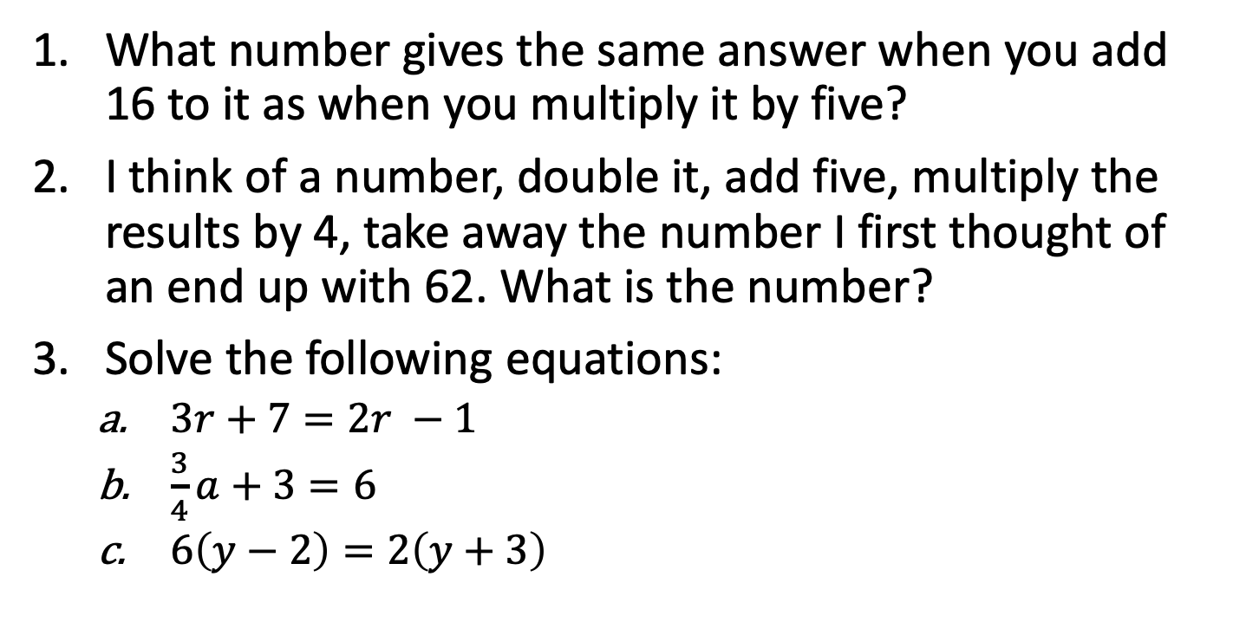
Revision
What number gives the same answer when you add 16 to it as when you multiply it by five?
I think of a number, double it, add five, multiply the results by 4, take away the number I first thought of an end up with 62. What is the number?
Solve the following equations:
$3r+7=2r −1$
$\frac{3}{4}a+3=6$
$6\left(y−2\right)=2\left(y+3\right)$

Slide 2
Univariate Data

Slide 3
CENSUS 2016
http://www.abc.net.au/news/2017-06-27/census-australia-as-100-people/8634318

Slide 4
DATA
PRIMARY
Data we collect ourselves, e.g. by experiment, survey etc.
SECONDARY
Data collected by other people, e.g. census (Australian Bureau of Statistics [ABS]).

Slide 5
What is your favourite sport? How old are you?
From a survey of 400 students, the data collected:
Age | AFL | Rugby | Tennis | Cycling
16 | 15 | 18 | 23 | 18
17 | 16 | 18 | 14 | 27
18 | 25 | 22 | 34 | 13
19 | 23 | 17 | 16 | 15
20 | 25 | 23 | 18 | 20
Variables
Considering ONE variable only - UNIVARIATE

Slide 6
DATA
CATEGORICAL
NUMERICAL
NOMINAL
ORDINAL
DISCRETE
CONTINUOUS

Slide 7
Categorical
What is the mode of transport for you to get to school?
What is your favourite singer?
Which suburb do you live in?
What do you think is your fitness level – unfit, fit, very fit?
How do you rate the TV series – one star to five stars?

Slide 8
CATEGORICAL
Particular group or category
NOMINAL
ORDINAL
No order
Based on the name only
Need a sub-group (names) to complete the description e.g. favourite colour is blue, green etc.
Label do suggest an order
Need a ranking to order the description, such as achievement levels: very high, high, satisfactory and so on.

Slide 9
Numerical
How many students are there in year 11?
How many people travel on the train to work?
How many dogs do I count when I go to the park?
The mass of a newly born baby in the month on June?
What is the half hourly temperature for the average day in June?

Slide 10
NUMERICAL
Number indicates a size
DISCRETE
CONTINUOUS
Only integer
Counted in exact values, such as goals scored in a football match, number of students and so on.
Can take on any value, not just integer.
Measured in a continuous decimal scale, such as mass, time, length and so on.

Slide 11
Examples
Classify each of the following data:
The number of students going on the ski trip.
The types of vehicles using a certain road.
The various pizza sizes available at a local takeaway.
The room temperature at various times during the day.

